Slide 1
Product Vision

Slide 2
Purpose of Product Vision
The product owner is the “voice of the customer” and needs to know the business domain as well as what customers want or might want
The product owner is responsible for the product vision which provides a summary of the idea or vision of what is to be built, the target group, the needs being fulfilled, features/functionality of the product, and the value.
Creating the product vision allows the development team to understand where the product is going and helps to limit assumptions. If the development team knows the ultimate goal they can be more aligned with the product owner.

Slide 3
Product Discovery
Do Just Enough Product Discovery Work
Minimize the amount of time spent on product discovery in order to accelerate time to market.
Explore key assumptions and risks in the product strategy and business model by testing and addressing them in an iterative fashion could use observations, interviews, surveys, and prototypes
Aim to get a good enough product out as fast as possible and then adapt it to the market feedback
Don’t rush the necessary work, and resist the temptation to jump start building the actual product
If you can not confidently state why people are going to use your product, who those individuals are, what makes your product stand out from the crowd, and why it’s worthwhile then you are not in a position to develop the actual solution
https://www.linkedin.com/pulse/product-discovery-tips-roman-pichler/

Slide 4
Product Discovery
Talk to the Users
Don’t lose sight of the most important success factor, the people who are going to use the product
No point in coming up with a smart business model and sophisticated user interactions if you don’t know who the users are, what they may be struggling with, and what works well for them and what does not.
If the users don’t need and like your product, you will find it hard to make money and achieve product success
Meet target users face to face
Take a genuine interest in the people you meet. Have an open mind and let go of preconceived notions about the problem you think the users have or the solution you believe they need
https://www.linkedin.com/pulse/product-discovery-tips-roman-pichler/

Slide 5
Product Discovery
Don’t handoff product discovery work
The people involved in product discovery should also participate in building the actual solution
Stakeholders should regularly attend product strategy and roadmap reviews as well as sprint review meetings
Handing off the discovery work is ineffective and wasteful, it requires detailing the knowledge acquired in form reports and other artifacts.
Refrain from having separate discovery and delivery teams.
https://www.linkedin.com/pulse/product-discovery-tips-roman-pichler/

Slide 6
Product Discovery
Consider Timeboxing product discovery activities
Knowing upfront how much time and effort will be required to carry out the necessary discovery work is tricky.
Instead timebox your product discovery work
A timebox is a fixed period of time such as one week that can not be extended. At the end of the time box the work stops and you reflect on what has been achieved. If the work has not been completed and your product strategy and business model still contain significant risks you can add another time box or stop the work
https://www.linkedin.com/pulse/product-discovery-tips-roman-pichler/

Slide 7
Product Discovery
Focus on Problem Validation, not solution building
Focus on nailing the value proposition, target group, business goals, business model, and stand-out features of the product – not on writing user stories, designing the user interface, or building the actual solution.
Goal should be mitigate the risk of building a product nobody wants or needs, not to figure out the product details
Consider using the Product Vision Board
https://www.linkedin.com/pulse/product-discovery-tips-roman-pichler/

Slide 8
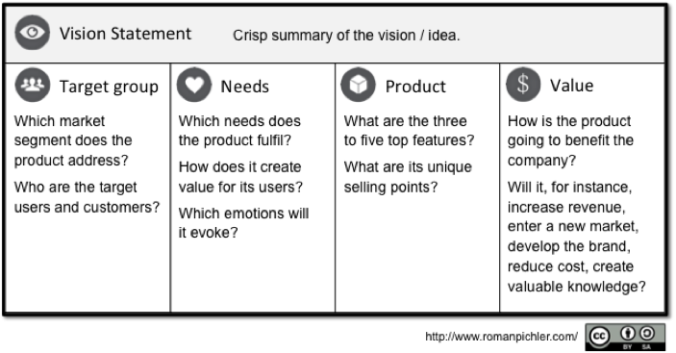
Product Vision Board
Start with 4 questions
Who are the users and customers?
Why would they use and buy the product?
What makes the product special? What are the key features?
What are the business goals the product should deliver and how are they met?
Create a vision board (http://romanpichler.com/tools/vision-board/)
Simple yet effective tool to capture vision and answer the four questions.

Slide 9
Vision Board
The Product Vision Board Introduction
https://www.youtube.com/watch?v=5Dd5f7TFnuk
(length 9:45 mins)

Slide 10
Creating a Compelling Product Vision
Creating and managing a successful product requires time and energy
You need to be convinced that what you are doing is right and have a clear vision of where to take the product

Slide 11
Describe the Motivation
Having an idea is great but not enough
Need a vision that guides everyone involved in making the product a success
The product vision is the overarching goal you are aiming for, the reason for creating the product
The product vision provides a continued purpose in an ever-changing world
The product vision acts as the product’s true north and provides motivation when the going gets tough
Ask yourself why you are excited to work on a product, why you care about it, what positive change the product should bring about, and how it will shape the future.
https://www.romanpichler.com/blog/tips-for-writing-compelling-product-vision/

Slide 12
Look Beyond the Product
Be clear on the difference between the product vision and the product without confusing the two
The product vision is the motivation for developing the product
The product is a means to achieve the overarching goal
An effective product vision goes beyond the product and captures the change the product should instigate
https://www.romanpichler.com/blog/tips-for-writing-compelling-product-vision/

Slide 13
Distinguish between Vision and Strategy
The product vision should not be a plan that shows how to reach a goal
Keep the product vision and product strategy separate
The product strategy is the path towards the goal
Keeping the two separate enables the strategy to change while keeping the vision
A vision is a prerequisite for choosing the right strategy. If you do not have an overarching goal then you can not decide how you best get there
https://www.romanpichler.com/blog/tips-for-writing-compelling-product-vision/

Slide 14
Employ a Shared Vision
Even with a the most beautiful vision for a product it is useless if the people involved in making the product a success do not buy into it
The product vision must be shared to be able to leverage the vision as the product’s true north, create alignment, and facilitate effective collaboration – everyone must have the same vision
Without a shared vision, people follow their own goals making it much harder to achieve product success
You can employ a collaborative visioning workshop to create a shared product vision
Use the product idea as input and ask the workshop attendees to capture their motivation for working on a product
https://www.romanpichler.com/blog/tips-for-writing-compelling-product-vision/

Slide 15
Choose an Inspiring Vision
The product vision should motivate people, connect them to the product, and inspire them
A vision focused on creating a benefit for others provides a deep motivation and a lasting inspiration. People excel because they believe that they are doing something meaningful and beneficial
Recommend including the beneficial change the product should create for others and for your business without trying to quantify or detail those benefits or the vision may no longer be able to guide you when you pivot.
https://www.romanpichler.com/blog/tips-for-writing-compelling-product-vision/

Slide 16
Think Big
Make a product vision broad and ambitious so it engages people and it can facilitate a change in the strategy
If the vision is broad and ambitious enough it does not refer to the actual product idea or a specific target group but aims for more
https://www.romanpichler.com/blog/tips-for-writing-compelling-product-vision/

Slide 17
Keep your Vision Short and Sweet
Since the vision is the ultimate reason for creating a product, it should be easy to communicate and to understand.
Other artifacts including the product strategy, business model, product backlog, and marketing plan provide the necessary details
The product vision should be short and sweet, easy to memorize and recite.
Employ a simple slogan that captures the vision
“Simplicity is the ultimate sophistication”
https://www.romanpichler.com/blog/tips-for-writing-compelling-product-vision/

Slide 18
Use the Vision to Guide your Decisions
Use the product vision to guide your product decisions and to focus everyone on the ultimate reason for creating the product.
The vision alone is not enough it is a first filter for new ideas and change requests
Anything that helps you move closer to your vision such as a new feature, a change of direction, or a new technology is helpful and should be considered. Anything that does not is not beneficial and should probably be discarded
https://www.romanpichler.com/blog/tips-for-writing-compelling-product-vision/

Slide 19
Team Activity
Within your breakout rooms you will:
Begin to brainstorm ideas for a software product you would want to work on. This could be an app or a software product of any type.
Recommended to start with an existing product and compete against it by evolving a new product. This way you have a starting point but you can start from scratch if you want.
Remember to think big and think about software products that you would want to create and could have a large impact (think about new areas, think about new problems that need solved).
Begin to fill out the product vision board which is in Assignment 6
We will return to the main room a few minutes before the end of the class to get an update from each team

